Slide 1

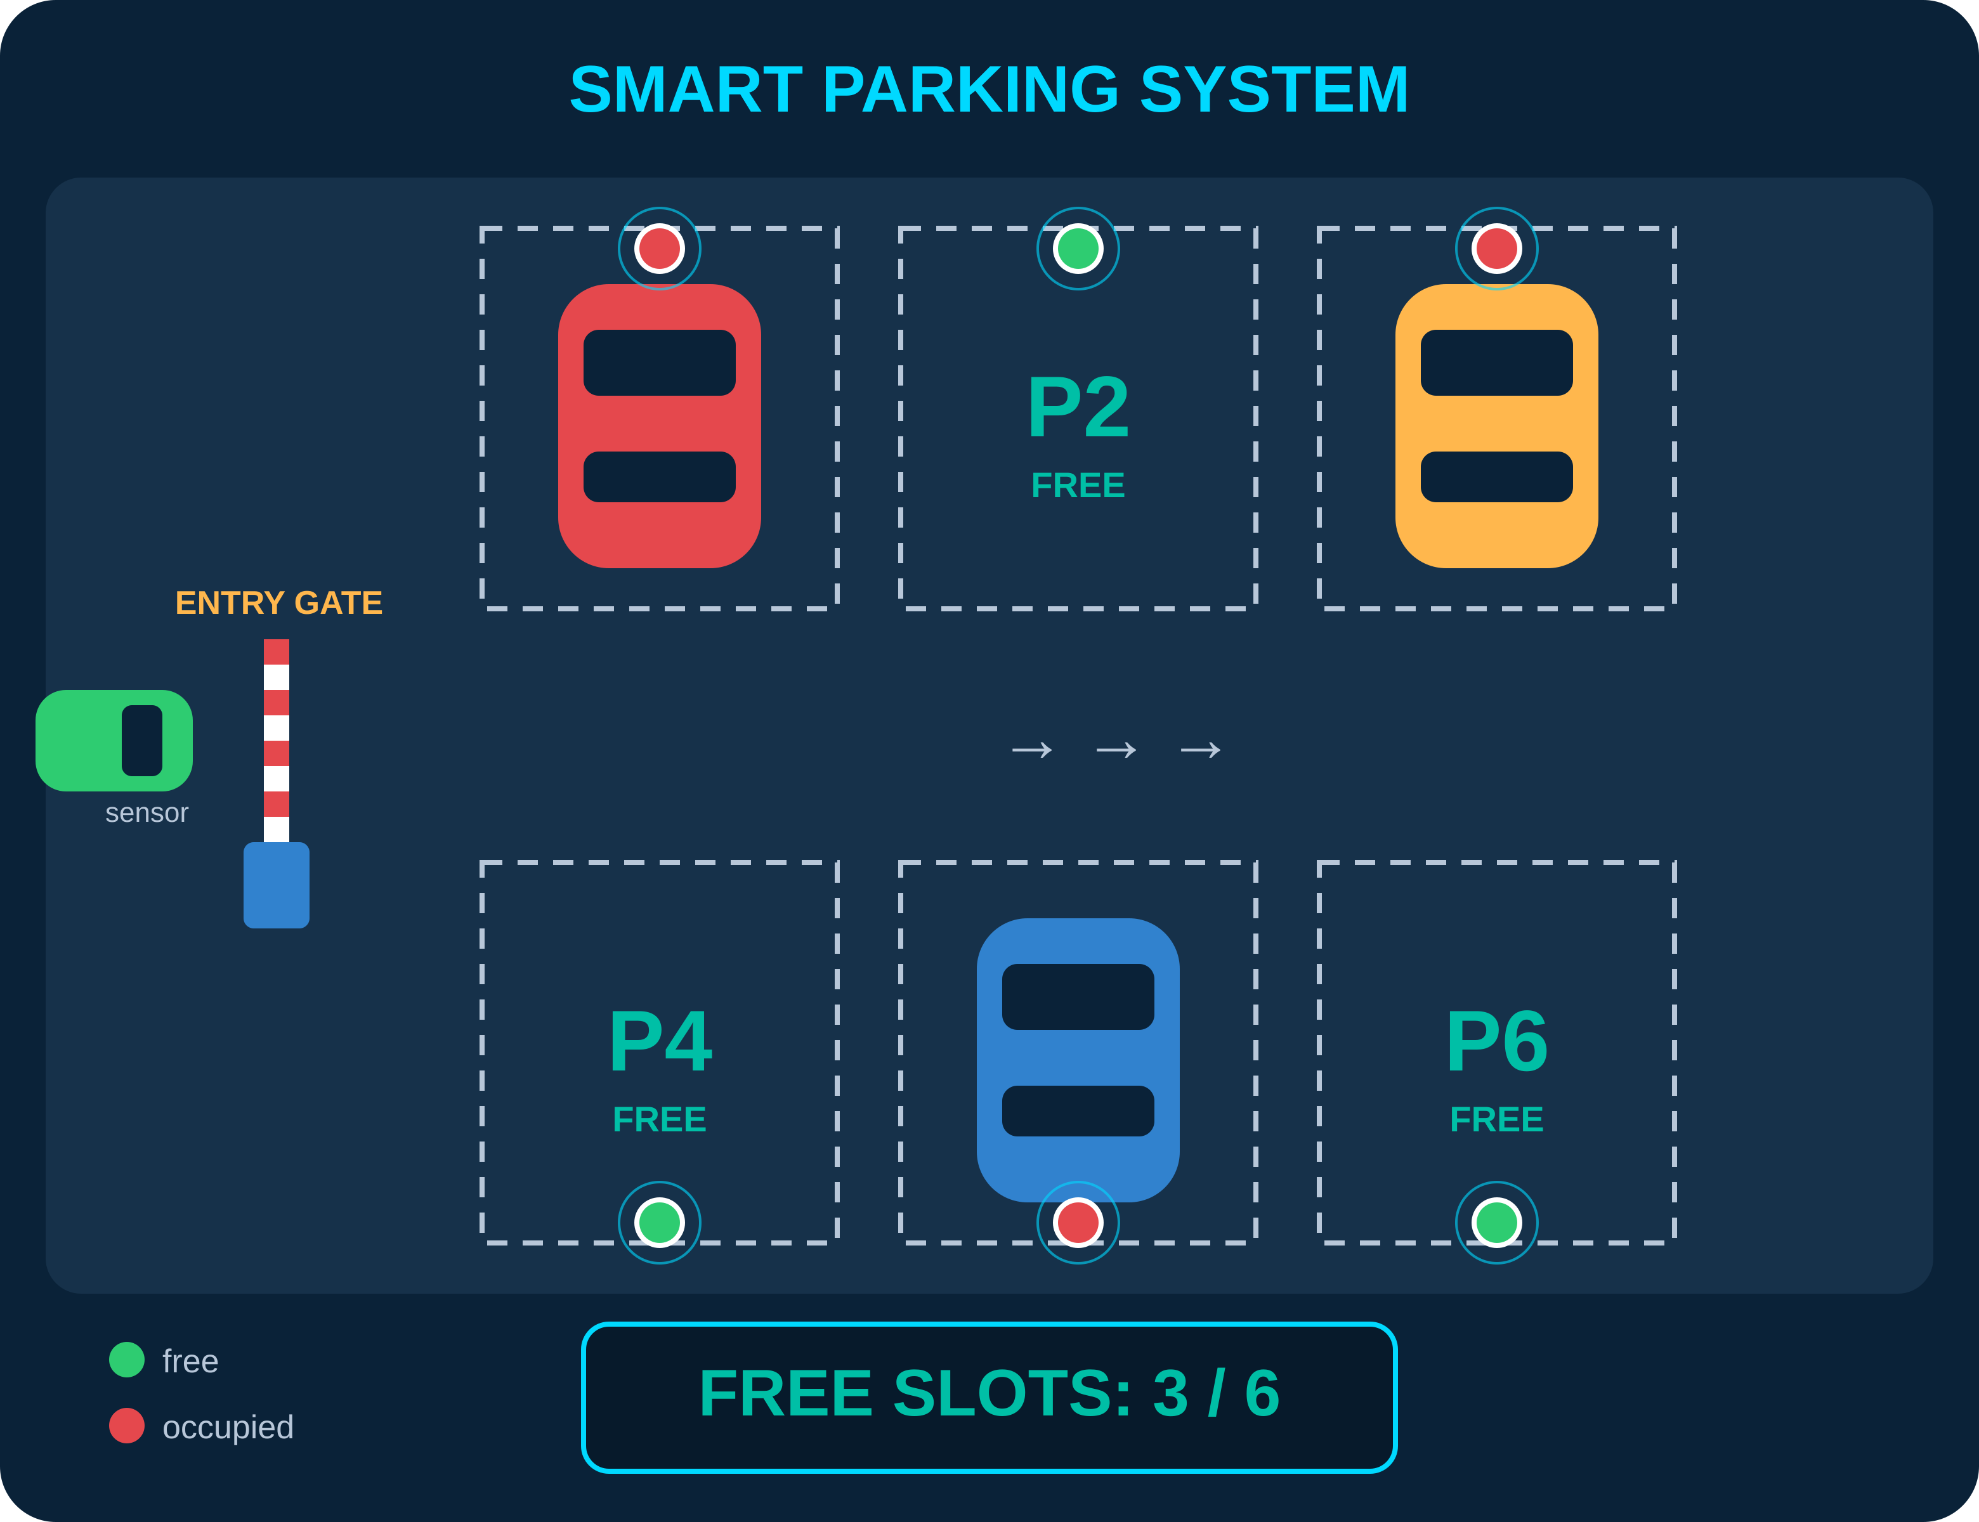
Making Decisions & Doing Maths:
Combinational Logic & the ALU
Module 2 – The First Major Computational Block of the RISC-V CPU
TEAM MEMBERS
2620030600 – JETHENDRA VARDHAN
2620030602 – LAXMI PRAGYA
2620030606 – VEDA CHANDRA
2620030636 – CHANDRA PAUL
Real-world example: sensors give 0/1 inputs; digital logic decides slot availability and when to lift the entry barrier.
2620030675 – SRIKRISHNA
Inputs
→
Combinational Logic
→
Decisions & Maths
→
ALU
→
CPU
Module 2 · Combinational Logic & the ALU
1 / 8

Slide 2
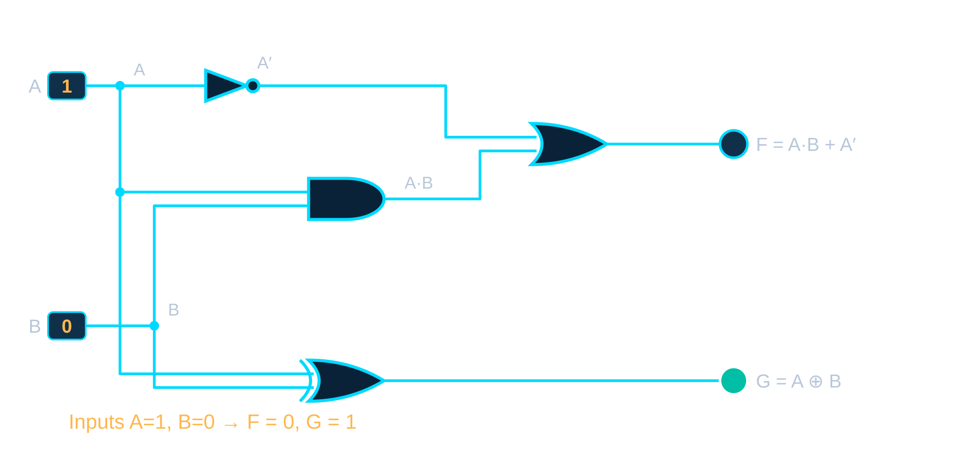
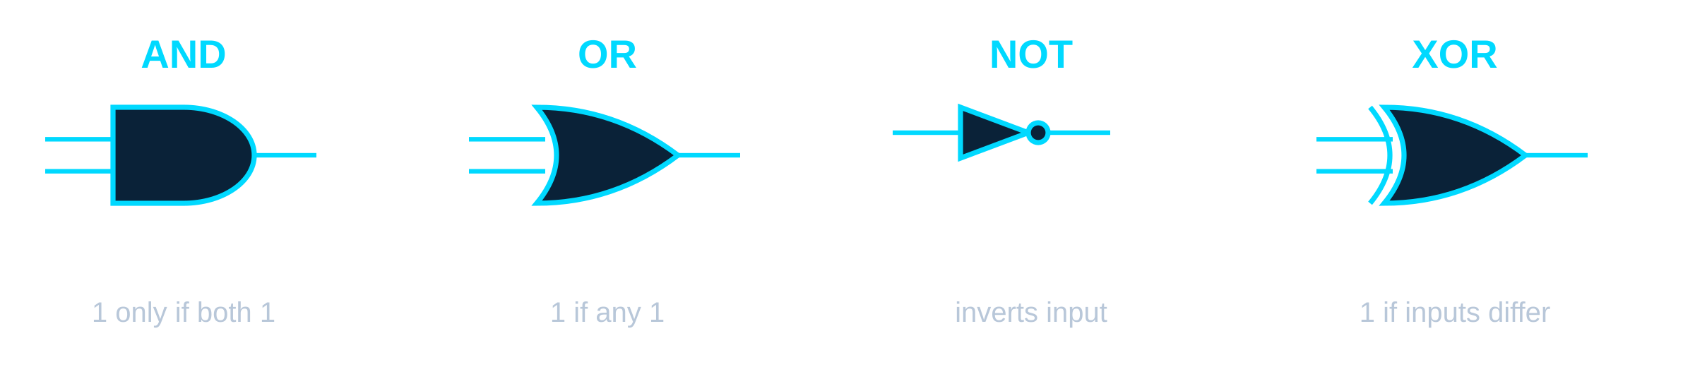
Combinational Logic – Decisions from Current Inputs
Output depends only on current inputs
No memory – nothing is stored
No previous-state dependency
Basic gates: AND, OR, NOT, XOR
Foundation of arithmetic and decision-making circuits
PROBLEM STATEMENT
Logisim-style circuit: A, B → AND / OR / NOT / XOR → output LED
How can simple logic gates be combined to perform arithmetic, comparisons and decisions required by a CPU?
Module 2 · Combinational Logic & the ALU
2 / 8

Slide 3
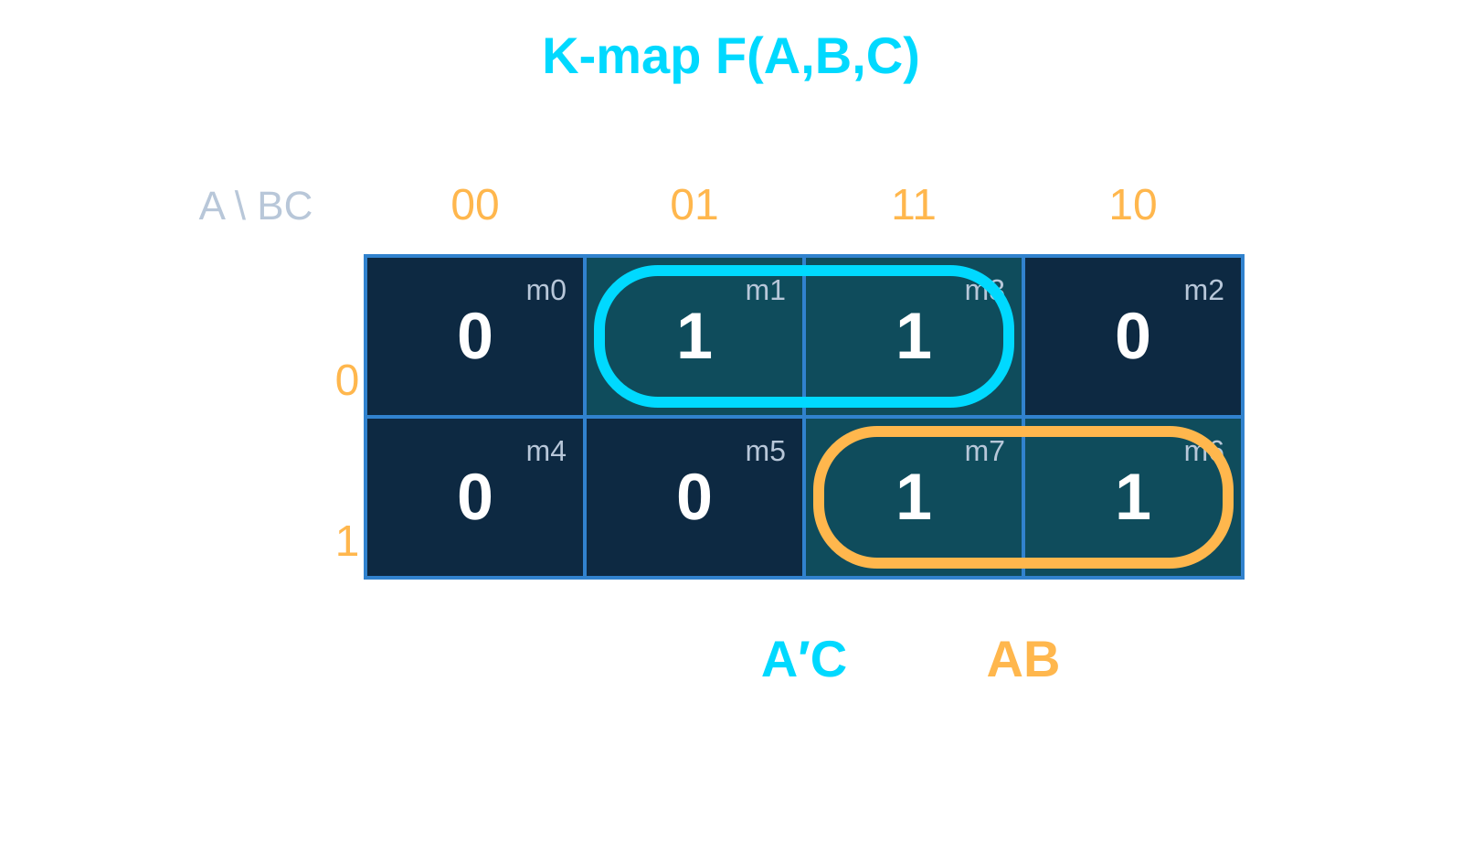
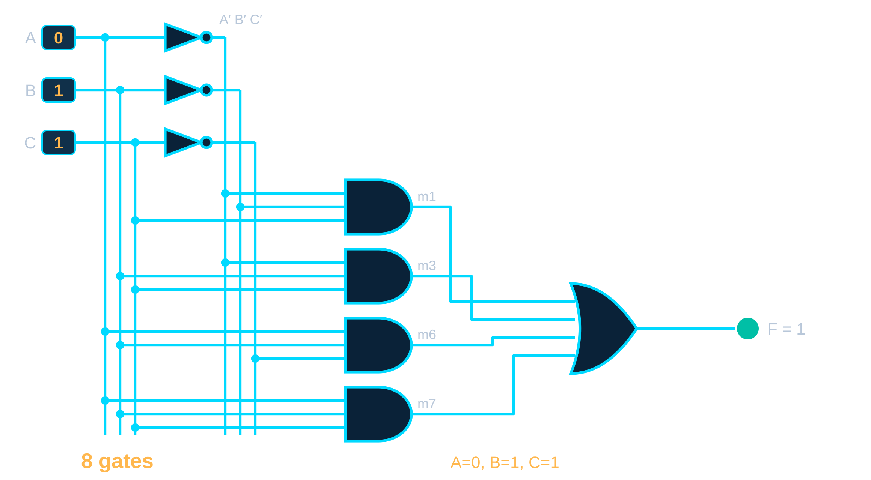
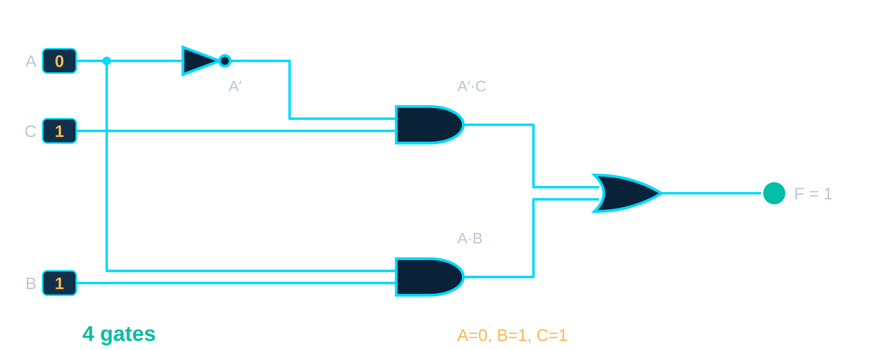
Karnaugh Maps – Simplifying Digital Logic
A | B | C | F
0 | 0 | 0 | 0
0 | 0 | 1 | 1
0 | 1 | 0 | 0
0 | 1 | 1 | 1
1 | 0 | 0 | 0
1 | 0 | 1 | 0
1 | 1 | 0 | 1
1 | 1 | 1 | 1
Truth Table → K-Map → Boolean Expression → Circuit
F = Σm(1,3,6,7) = A′C + AB
Fewer gates
Faster circuits
Lower hardware cost
Lower power consumption
BEFORE – unsimplified: 8 gates
AFTER – F = A′C + AB: 4 gates (50% fewer)
Module 2 · Combinational Logic & the ALU
3 / 8

Slide 4
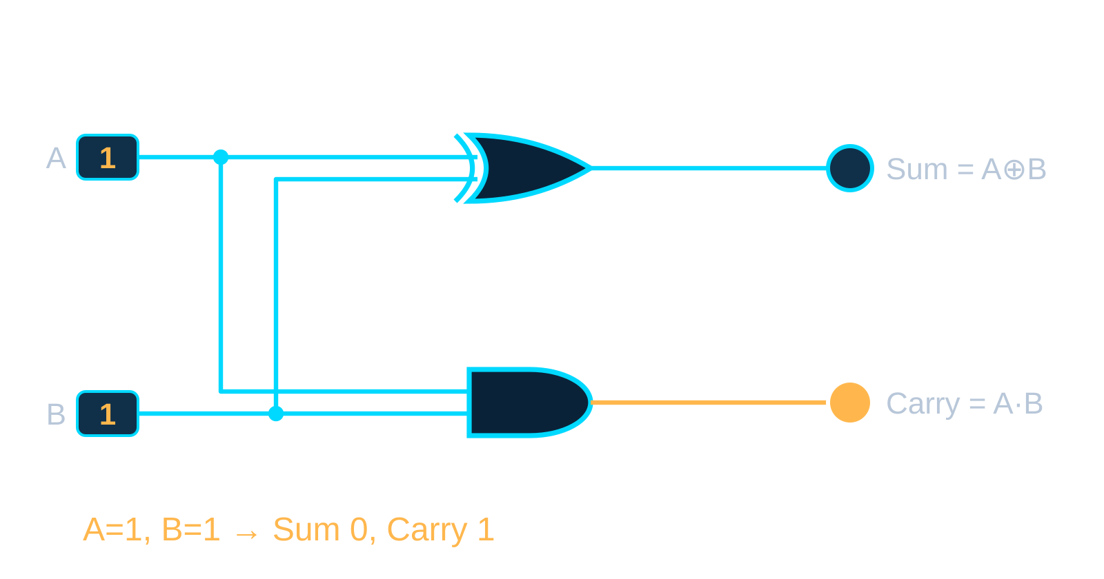
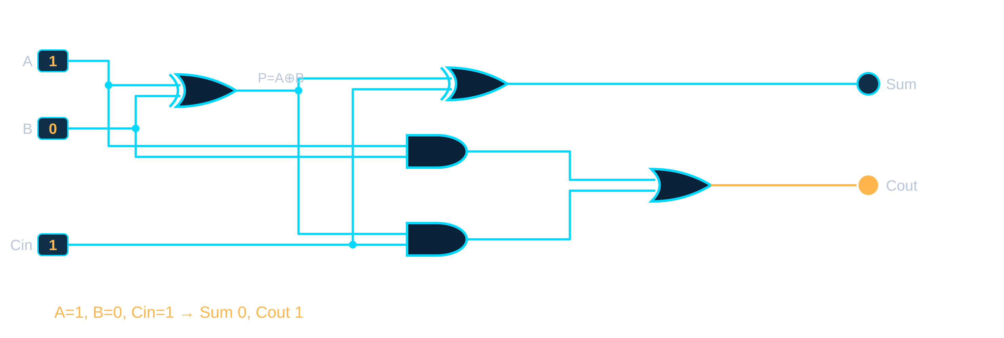
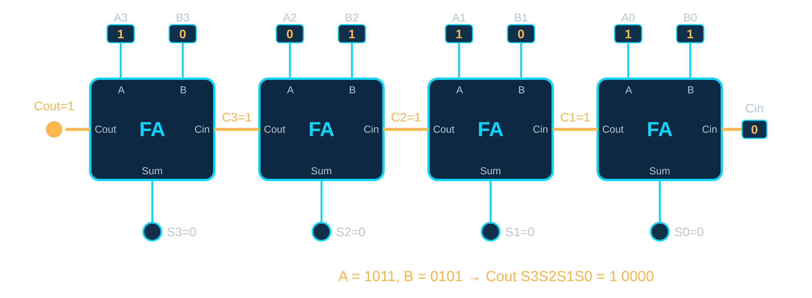
Arithmetic Circuits – Building Binary Addition
HALF ADDER · Sum = A⊕B (XOR), Carry = A·B (AND)
FULL ADDER · Cin carries the overflow of the previous stage
4-BIT RIPPLE-CARRY ADDER · four Full Adders chained
1011 + 0101 = 10000
Carry ripples C1 → C2 → C3 → Cout
Every stage sums to 0 and passes a carry of 1
Wider adders = longer propagation delay
Module 2 · Combinational Logic & the ALU
4 / 8

Slide 5
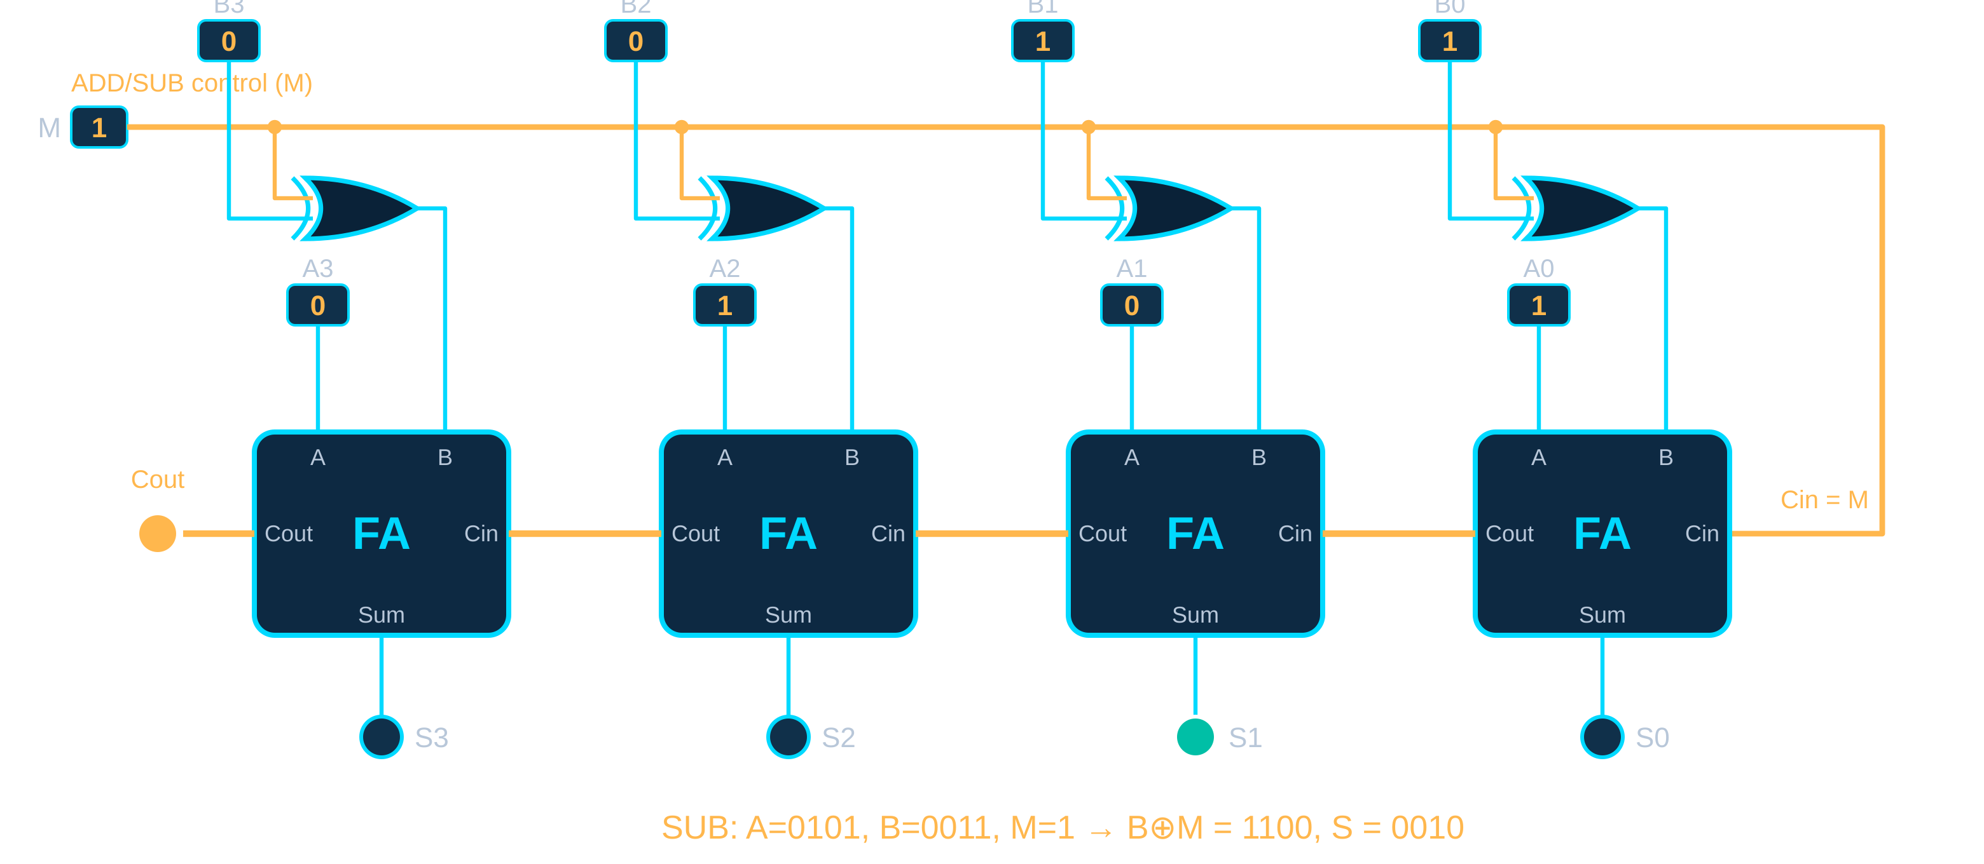
Two's Complement – Building an Adder/Subtractor
Two's complement lets the adder also subtract
Invert B (~B)
Add 1 (Cin = 1)
XOR gates flip B when M = 1
One adder, two operations
M = 0 → A + B (ADD)
M = 1 → A + (~B + 1) (SUBTRACT)
ADD (M = 0)
SUBTRACT (M = 1)
0011 + 0010 = 0101
0101 + 1100 + 1 = 0010
M drives both the XOR gates and the carry-in.
3 + 2 = 5
5 − 3 = 2
Module 2 · Combinational Logic & the ALU
5 / 8

Slide 6
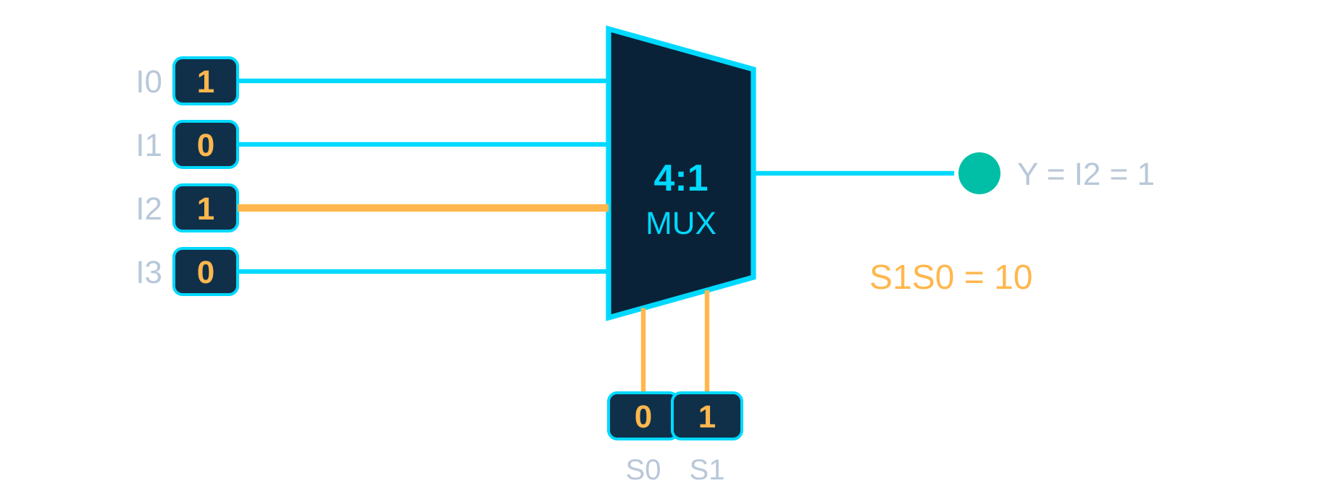
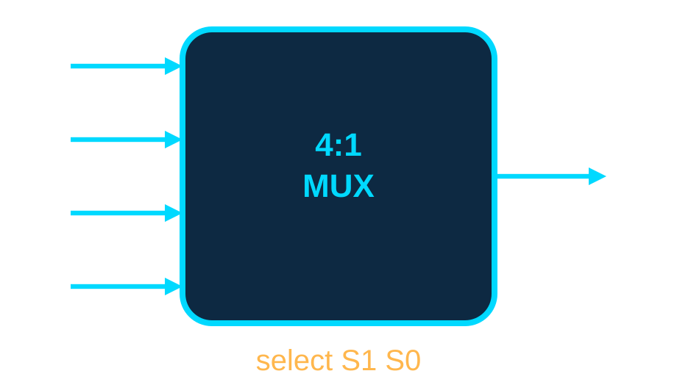
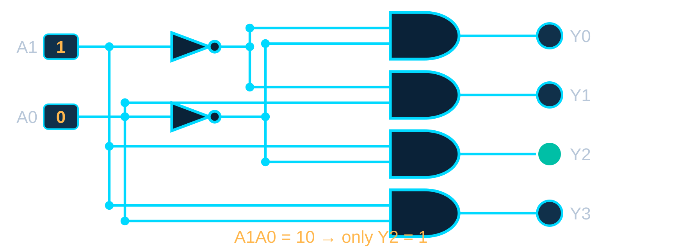
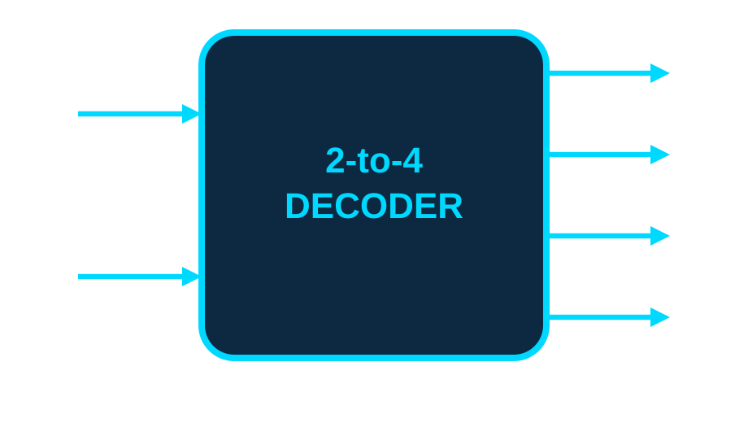
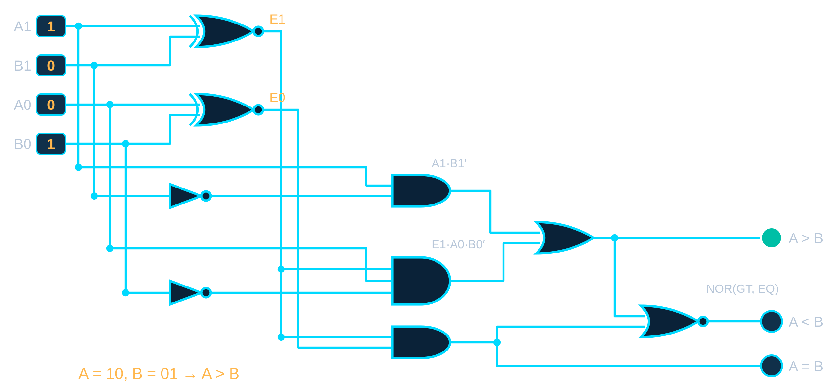
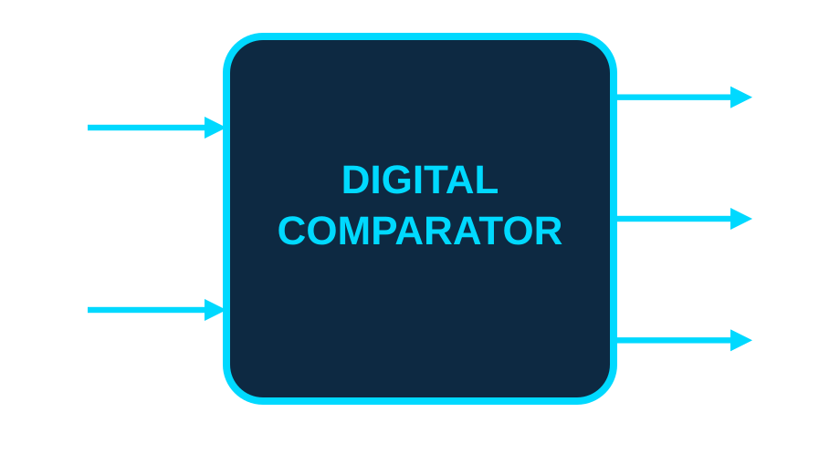
Data Routing and Comparison Blocks
A. MULTIPLEXER – data selector
S1 S0 | Y
00 | I0
01 | I1
10 | I2
11 | I3
Example: I = 1,0,1,0 and S1S0 = 10 → Y = I2 = 1
B. DECODER – one active output
A1 A0 | Y0 | Y1 | Y2 | Y3
00 | 1 | 0 | 0 | 0
01 | 0 | 1 | 0 | 0
10 | 0 | 0 | 1 | 0
11 | 0 | 0 | 0 | 1
Example: A1A0 = 10 → only Y2 is HIGH
C. COMPARATOR – compares A and B
A | B | Result
10 | 01 | A > B
01 | 01 | A = B
00 | 11 | A < B
E1 = A1 XNOR B1, E0 = A0 XNOR B0
EQ = E1·E0
GT = A1·B1′ + E1·A0·B0′
LT = NOR(GT, EQ)
Module 2 · Combinational Logic & the ALU
6 / 8

Slide 7
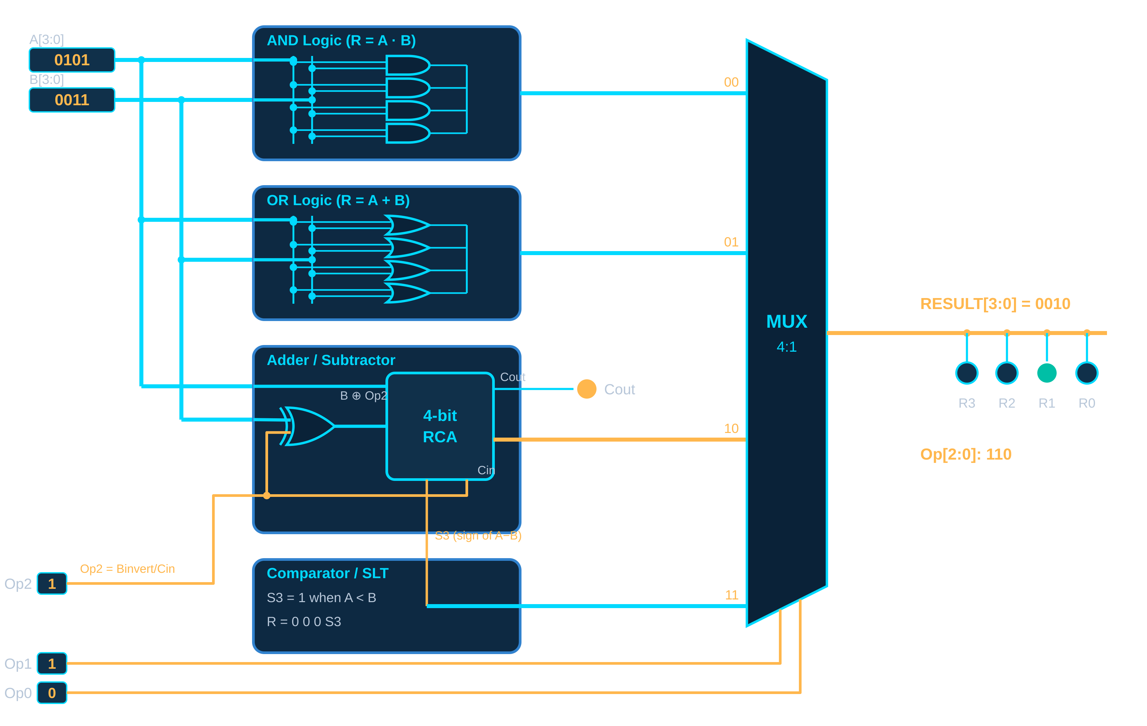
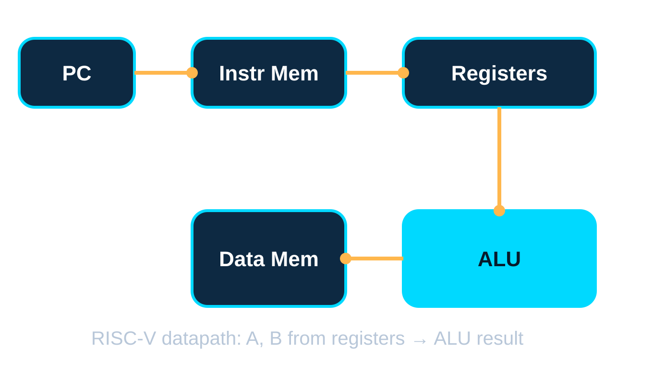
ALU – The CPU's Calculator
Operation | Op[2:0]
AND | 000
OR | 001
ADD | 010
SUB | 110
SLT | 111
ALU → RISC-V CPU datapath
AND · OR · ADD/SUB · SLT run in parallel; the MUX picks one result using Op[1:0].
Module 2 · Combinational Logic & the ALU
7 / 8

Slide 8
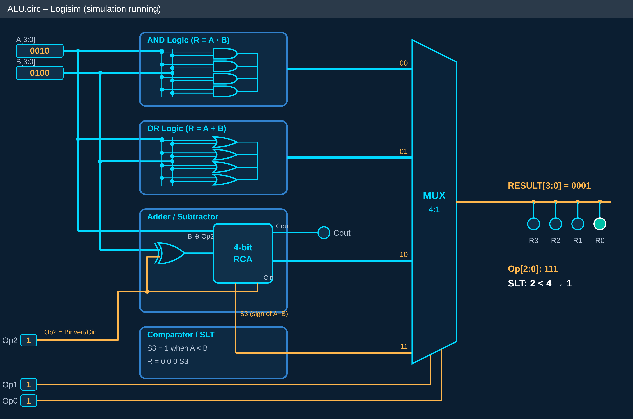
Milestone – A Working ALU in the Simulator
Operation | A | B | Expected | Result
ADD | 0011 | 0010 | 0101 | ✓ Pass
SUBTRACT | 0101 | 0011 | 0010 | ✓ Pass
AND | 1100 | 1010 | 1000 | ✓ Pass
OR | 1100 | 1010 | 1110 | ✓ Pass
SLT | 0010 | 0100 | 1 | ✓ Pass
1 Specification
2 Boolean Logic
3 K-Map Simplification
4 Circuit Design
5 Logisim Simulation
6 Testing
7 Working ALU
Combinational logic depends only on current inputs
K-maps simplify circuits
Adders do binary arithmetic; two's complement enables subtraction
MUXes route data; decoders select outputs
Comparators perform equality and ordering
These blocks combine to form the ALU
The ALU is a major computational subsystem of the RISC-V CPU
“Working ALU Successfully Designed, Simulated and Tested.”
Module 2 · Combinational Logic & the ALU
8 / 8

Slide 9


